Slide 1
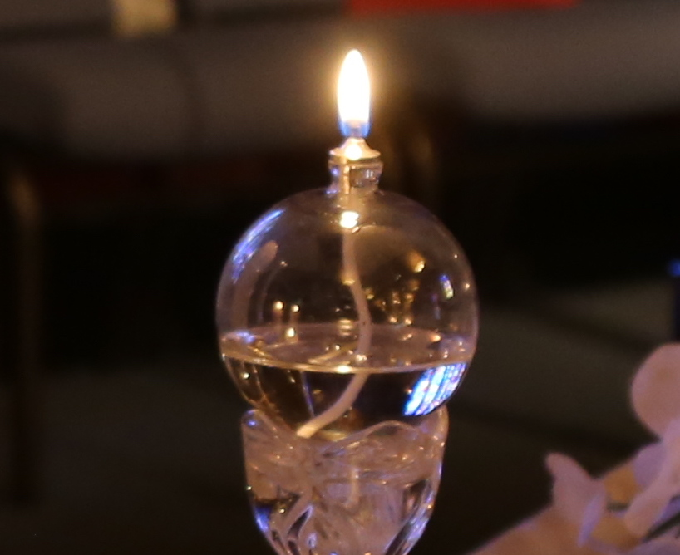
Bishop Sandra Steiner Ball

Slide 2
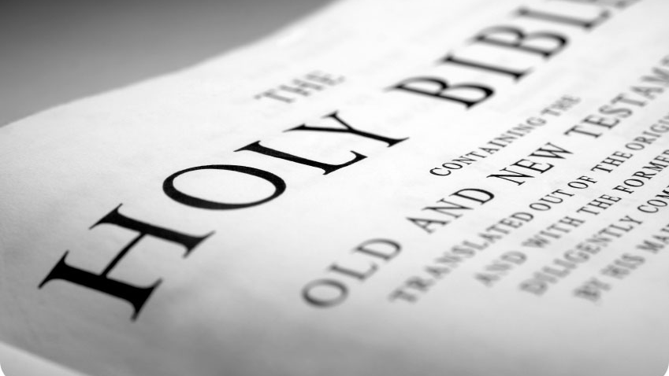
Ephesians 4:1-6; 29-32 (NRSV)
“I therefore, the prisoner in the Lord, beg you to lead a life worthy of the calling to which you have been called,

Slide 3
²with all humility and gentleness, with patience, bearing with one another in love, ³making every effort to maintain the unity of the Spirit in the bond of peace.

Slide 4
⁴There is one body and one Spirit, just as you were called to the one hope of your calling, ⁵one Lord, one faith, one baptism,

Slide 5
⁶one God and Father of all, who is above all and through all and in all.”

Slide 6
“²⁹Let no evil talk come out of your mouths, but only what is useful for building up, as there is need, so that your words may give grace to those who hear.

Slide 7
³⁰And do not grieve the Holy Spirit of God, with which you were marked with a seal for the day of redemption.

Slide 8
³¹Put away from you all bitterness and wrath and anger and wrangling and slander, together with all malice,

Slide 9
³²and be kind to one another, tenderhearted, forgiving one another, as God in Christ has forgiven you.”

Slide 10
God Loves You. God Desires You. Jesus Saves.

Slide 11
2019 Special Session of the General Conference
We can
Do better

Slide 12
What We Know—What Did Not Change

Slide 13
“We affirm that all persons are individuals of sacred worth, created in the image
of God. . .

Slide 14
“We affirm God’s grace is available to all. . . We implore families and churches not to reject or condemn lesbian and gay members and friends.”
¶ 161.G

Slide 15
All persons, regardless of age, gender, marital status, or sexual orientation,
are entitled to have their human rights and civil rights ensured and to be protected against violence.

Slide 16
What We Know—What Did Not Change
¶ 341.6: Ceremonies that celebrate homosexual unions shall not be conducted by our ministers and shall not be conducted in our churches.

Slide 17
What We Know—What Did Not Change
Candidacy for Ordination ¶ 304.3:
The practice of homosexuality is incompatible with Christian teaching

Slide 18
What We Know—What Did Not Change
Therefore, self-avowed practicing homosexuals are not to be certified as candidates, ordained as ministers, or appointed to serve in The United Methodist Church.

Slide 19
What We Know—What Did Not Change
¶ 120: The mission of the Church is to make disciples of Jesus Christ for the transformation of the world.

Slide 20
¶ 202: The function of the local church, under the guidance of the Holy Spirit is to help people to accept and confess Jesus Christ as Lord and Savior and to live their daily lives in light of their relationship
with God.

Slide 21
The following changes are determined to be constitutional and will be added to the Book of Discipline.

Slide 22
If a Church enters a process to exit the UMC, they must pay their fair share of pension liability as a part of that process. Clergy who exit the denomination retain their pension, but pension funds must be converted to limit further liability.

Slide 23
Language will be added to the footnote that defines a self-avowed practicing homosexual. Someone who is living in a same-sex marriage, domestic partnership or civil union fits the definition of a self-avowed practicing homosexual.

Slide 24
Bishops are prohibited from consecrating bishops and prohibited from commissioning or ordaining self-avowed practicing homosexual persons.

Slide 25
Minimum penalties have been added for pastors who perform same gender weddings and are convicted by trial.

Slide 26
First offense – One-year suspension
without pay.
Second offense
– Not less than termination of
conference membership and revocation of credentials of
licensing, ordination, or
consecration.

Slide 27
The just resolution process clarifies that complainants shall be a party to just resolution process.

Slide 28
Language was added which allows a process for churches who disagree with the Church position on homosexuality to disaffiliate with the United Methodist Church. There are requirements for this process.

Slide 29
2019 GC Decisions Reaction
Annual Conferences do not have the authority to change the Book of Discipline

Slide 30
2019 GC Decisions Reaction
Pain across the spectrum, inside and outside the U.S.

Slide 31
2019 GC Decisions Reaction
A variety of conversations are happening

Slide 32
2019 GC Decisions Reaction
Every Annual Conference has a different context

Slide 33
2019 GC Decisions Reaction
We are not of one mind on this particular subject

Slide 34
2019 GC Decisions Reaction
We have a choice--focus on what divides or on what unites.

Slide 35
2019 GC Decisions Reaction
We have a God given, Christ given mission which we can only fulfill with LOVE

Slide 36
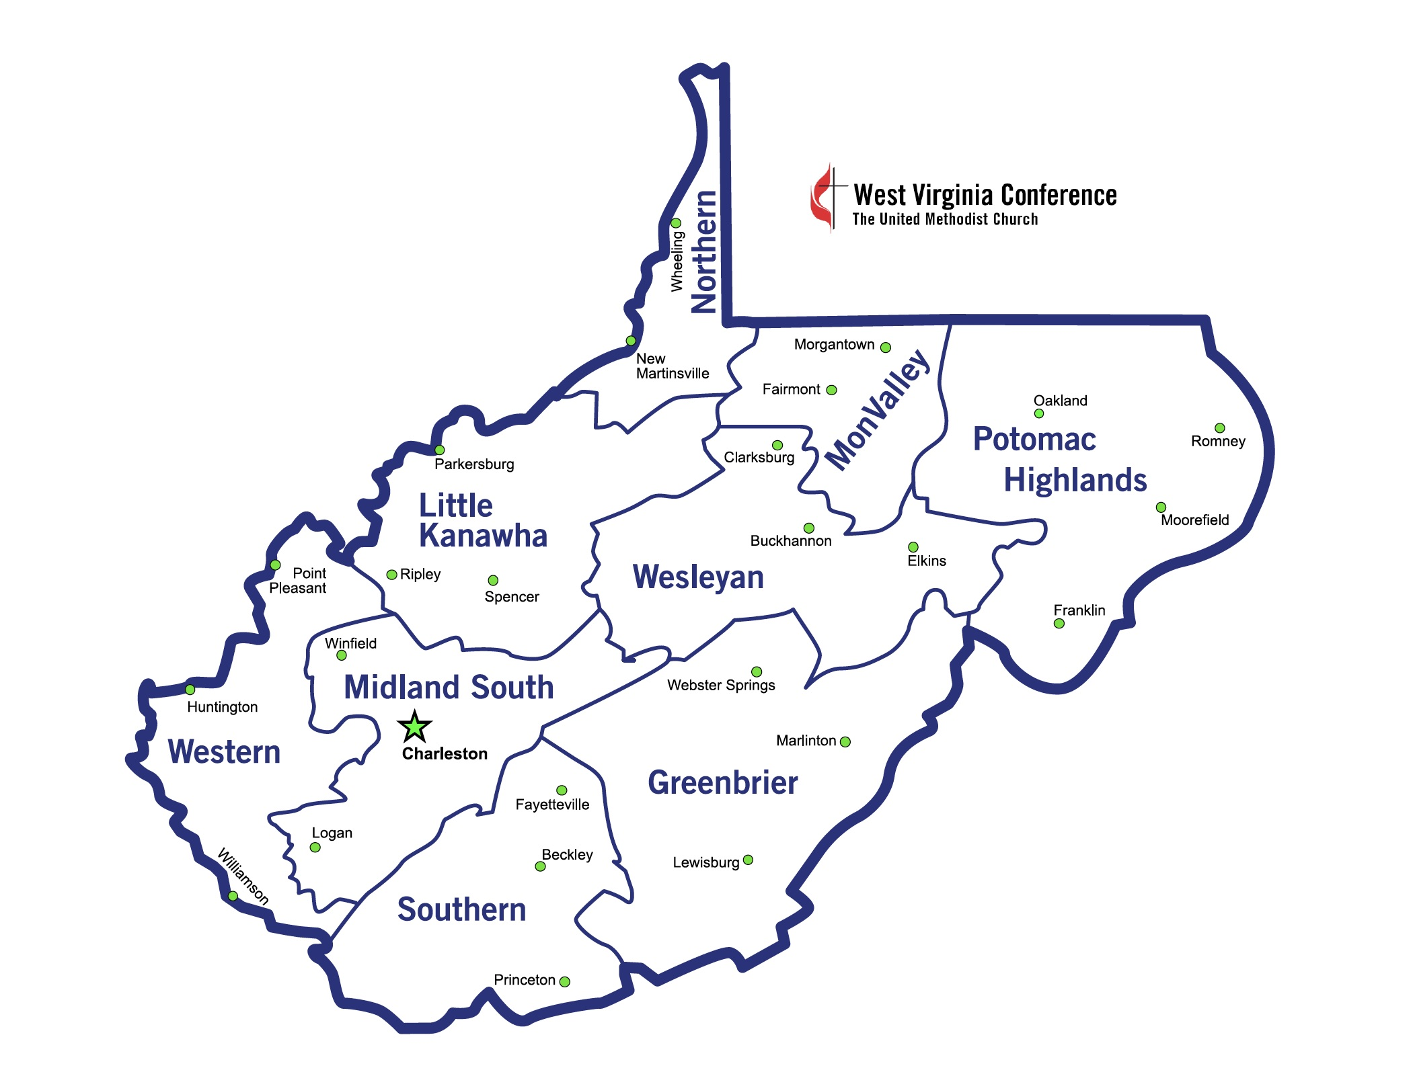
What Do We Do Now?

Slide 37
Population
not involved
in a religious congregation or community
61.7%

Slide 38
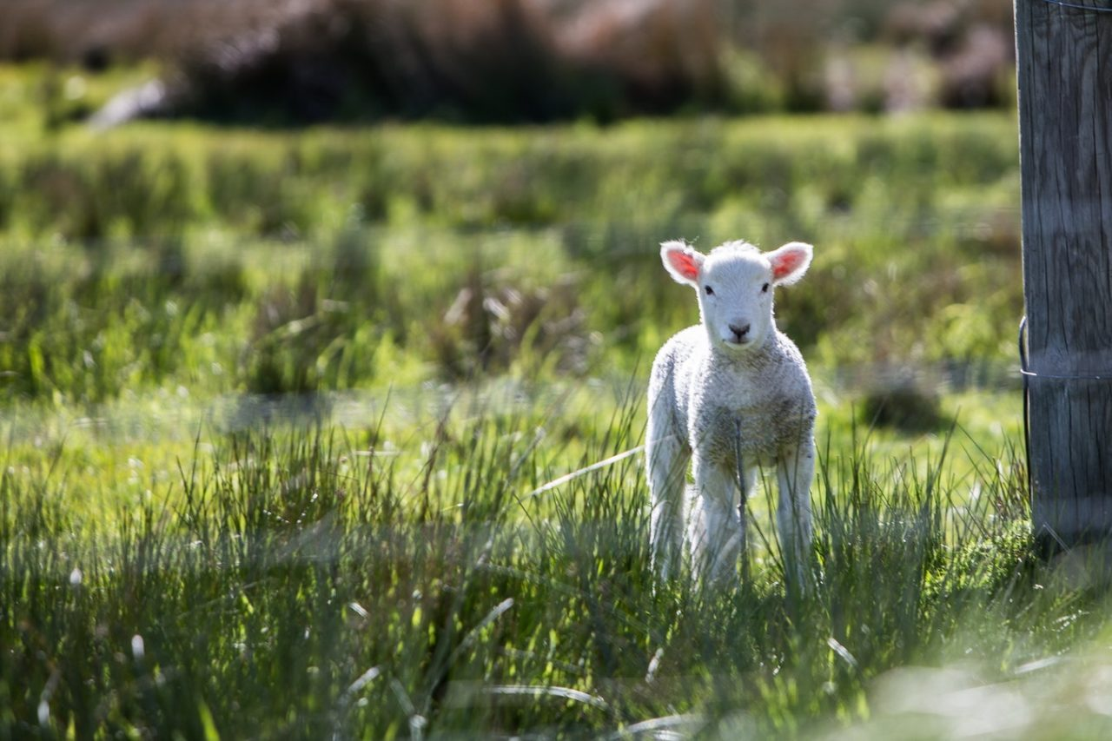
Luke 15:3-7
ONE > 99

Slide 39
Discussion Questions
What gives you hope during this time of anxiety?

Slide 40
Discussion Questions
How can we be faithful
and live together amid conflict?
What behaviors or actions can facilitate this?

Slide 41
Discussion Questions
What is your deepest Christ
centered missional passion?
What will you do to move this mission forward in your local congregation?

Slide 42
We influence the mission and ministry of Christ in our communities and in our congregations.
What is the message we desire people to see and hear and experience from your local church?

Slide 43
We influence the mission and ministry of Christ in our communities and in our congregations.
For what do you want your local church to be known?

Slide 44
We influence the mission and ministry of Christ in our communities and in our congregations.
What can you do to facilitate the witness desired?

Slide 45
Discussion Questions
What are the needs of the community that surrounds your congregation?
How will you help your congregation be
the body of Christ when you return home?

Slide 46
General Conference 2020

Slide 47
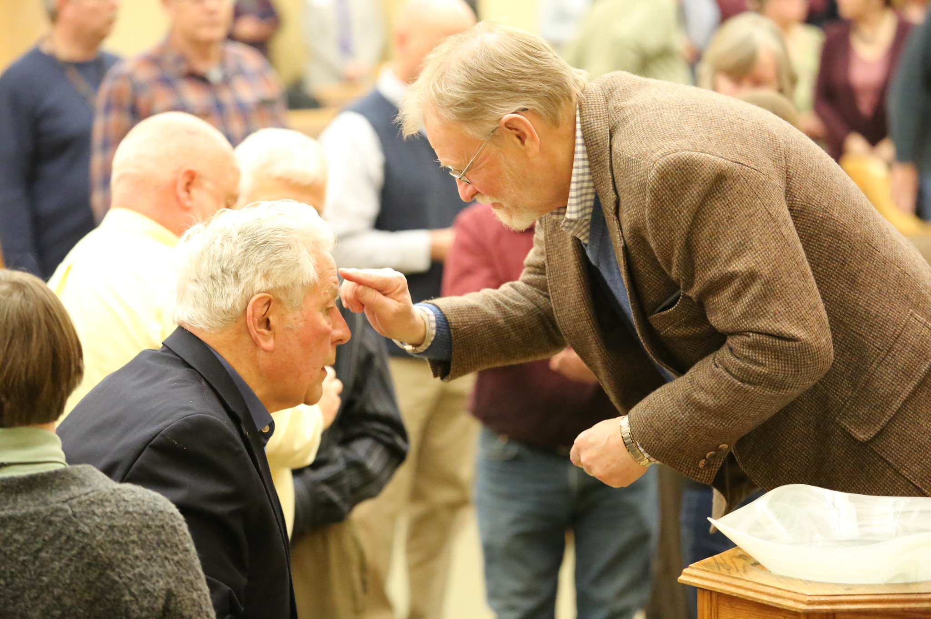

Slide 48
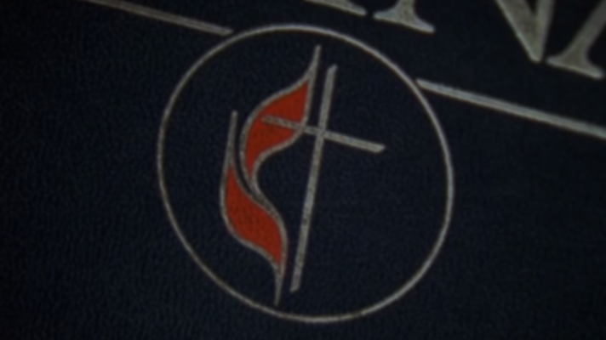
God forgave my sin in Jesus’ name, I’ve been born again in Jesus’ name, and in Jesus’ name I come to you, to share his love as he told me to.

Slide 49
He said, “Freely, freely you have received, freely, freely give. Go in my name, and because you believe, others will know that I live.”

Slide 50
All power is given in Jesus’ name, in earth and heaven in Jesus’ name, and in Jesus’ name I come to you, to share his power as he told me to.

Slide 51
He said, “Freely, freely you have received, freely, freely give. Go in my name, and because you believe, others will know that I live.”

